Slide 1
BIG DATA – HADOOP AND COMPONENTS
PREPARED BY Sanjana Bal

Slide 2
What is Big Data?
Big data can be defined as large sets of Data (structured, unstructured or semi structured) that are so large or complex that traditional data processing application softwares are inadequate to deal with them.
Big data analytics refers to the use of predictive analytics, user behavior analytics, or certain other advanced data analytics methods that extract value from data, and seldom to a particular size of data set.
There are a number of concepts associated with big data: originally there were 3 concepts volume, variety, velocity. Other concepts later attributed with big data are veracity and value.

Slide 3
Characteristics of BIG DATA- The 5Vs
Volume: The quantity of generated and stored data. The size of the data determines the value and potential insight- and whether it can actually be considered big data or not. For Example- Facebook generates 500 terabytes of data every day.
Variety: The type and nature of the data. This helps people who analyze it to effectively use the resulting insight. eg. Data can be audio , video or text. Structured or unstructured.
Velocity: In this context, the speed at which the data is generated and processed to meet the demands and challenges that lie in the path of growth and development. eg. Clickstreams and ad impressions capture user behavior at millions of events per second.
Variability: Inconsistency of the data set can hamper processes to handle and manage it. Changing data and changing model.
Veracity: The quality of captured data can vary greatly, affecting the accurate analysis.

Slide 4
The need for Big Data Analytics in today’s world
Faster, better decision making. With the speed of Hadoop and in-memory analytics, combined with the ability to analyze new sources of data, businesses are able to analyze information immediately – and make decisions based on what they’ve learned.
Cost reduction. Big data technologies such as Hadoop and cloud-based analytics bring significant cost advantages when it comes to storing large amounts of data – plus they can identify more efficient ways of doing business.
New products and services. With the ability to gauge customer needs and satisfaction through analytics comes the power to give customers what they want. Davenport points out that with big data analytics, more companies are creating new products to meet customers’ needs.

Slide 5
Sectors using Big Data
Education (ex: Analyzing student performance)
Government (ex: Aadhar scheme)
IT
Health Care
Manufacturing
Retail (ex: Day to day transactions and report)
Finance
Media
Banking

Slide 6

Hadoop - Introduction
Hadoop was created by computer scientists Doug Cutting and Mike Cafarella in 2005. It was inspired by Google’s Mapreduce.
In 2016 , Apache Hadoop became a registered trademark of the Apache Software Foundation.
Hadoop is an open source, Java-based programming framework thats allows for the distributed processing of large data sets across clusters of computers using simple programming models.
Hadoop runs applications using the map-reduce algorithm where the data is processed in parallel on different CPU nodes
The distributed file system facilitates rapid data transfer rates among nodes and allows the system to continue operating incase of a node failure.

Slide 7
Why is Hadoop needed for analysis?
data exploration with full datasets
Mining larger datasets
Large scale pre-processing of raw data
Data agility

Slide 8
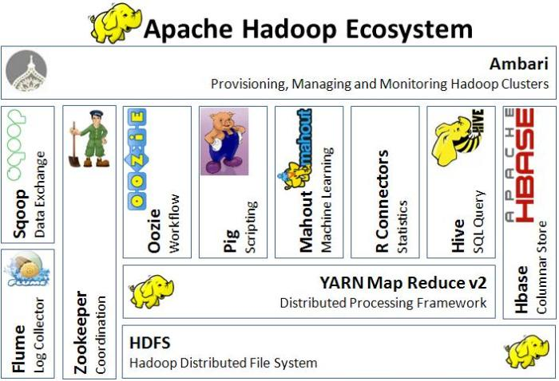

Slide 9
Key Components of Hadoop
Hadoop Distributed File System (HDFS): A distributed file system that provides high-throughput access to application data. It runs on top of an existing file system. It is designed to handle large files with streaming data access patterns.
Hadoop MapReduce- This is referred to as the heart of Hadoop. Mapreduce is the original framework for writing applications that process large amounts of structured and unstructured data stored in HDFS
Yarn Framework: A framework for job scheduling and cluster resource management. A YARN-based system for parallel processing of large data sets.

Slide 10
Other components of Hadoop ecosystem
HBase: A scalable, distributed database that supports structured data storage for large tables.
Hive: A data warehouse infrastructure that is built on top of Hadoop and has a SQL -like interface called HiveQL. It compiles a query a Mapreduce jobs and runs them in cluster.
Pig: A high-level data-flow language and execution framework for parallel computation.
Flume: A distributed, reliable, and available service for efficiently collecting, aggregating, and moving large amounts of streaming event data.
ZooKeeper: A high-performance coordination service for distributed applications.

Slide 11
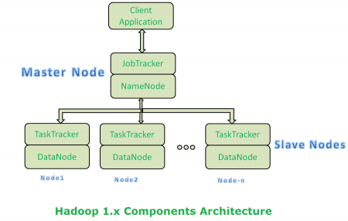
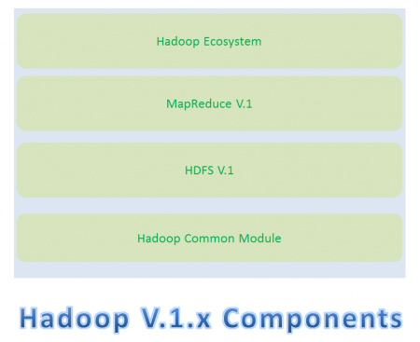
Hadoop Architecture 1.x

Slide 12
Limitations of Architecture 1.x
It is not suitable for Real-time Data Processing and data Streaming.
It supports up to 4000 Nodes per Cluster.
It has a single component : Job Tracker to perform many activities like Resource Management, Job Scheduling, Job Monitoring, Re-scheduling Jobs etc.
Job Tracker is the single point of failure.
It does not support Multi-tenancy Support.
It supports only one Name Node and One Namespace per Cluster.
It runs only Map/Reduce jobs.
It follows Slots concept in HDFS to allocate Resources (Memory, RAM, CPU). It has static Map and Reduce Slots. That means once it assigns resources to Map/Reduce jobs, it cannot re-use them even though some slots are idle.
For Example:- Suppose, 10 Map and 10 Reduce Jobs are running with 10 + 10 Slots to perform a computation. All Map Jobs are doing their tasks but all Reduce jobs are idle. We cannot use these Idle jobs for other purpose.

Slide 13
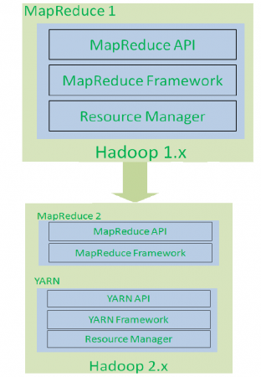
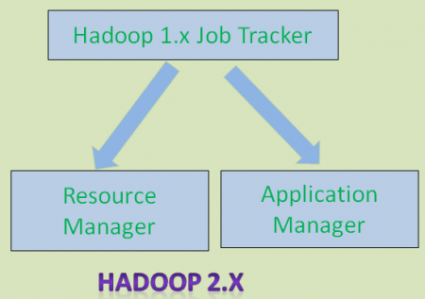
Re-Architecture of 1.x

Slide 14
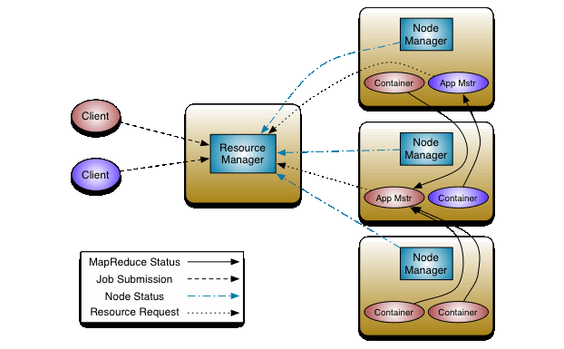
Hadoop Architecture – 2.x

Slide 15
Components of Hadoop 2.X architecture
The fundamental idea of YARN is to split up the functionalities of resource management and job scheduling/monitoring into separate daemons. The idea is to have a global Resource Manager (RM) and per-application Application Master (AM).
The main components of Hadoop 2.x architecture is,
Resource Manager
Node Manager
Application Master
Container
Scheduler

Slide 16
Advantages of 2.x
By decoupling Map Reduce component responsibilities into different components.
By Introducing new YARN component for Resource management.
By decoupling component’s responsibilities, it supports multiple namespace, Multi-tenancy, Higher Availability and Higher Scalability.
Hadoop 2.x YARN Benefits
Highly Scalability
Highly Availability
Supports Multiple Programming Models
Supports Multi-Tenancy
Supports Multiple Namespaces
Improved Cluster Utilization
Supports Horizontal Scalability

Slide 17
Resource Manager and Node Manager, Container
Resource Manager: The Resource Manager is the ultimate authority that arbitrates resources among all the applications in the system. The Resource Manager has two main components:
Scheduler
Applications Manager.
Node Manager: It is the per-machine framework agent who is responsible for containers, monitoring their resource usage (CPU, memory, disk, network) and reporting the same to the Resource Manager/Scheduler.
Application Master: The per-application Application Master is, in effect, a framework specific library and is tasked with negotiating resources from the Resource Manager and working with the Node Manager(s) to execute and monitor the tasks.
Container: Each Master Node or Slave Node contains set of Containers. Container is a portion of Memory in HDFS (Either Name Node or Data Node). In Hadoop 2.x, Container is similar to Data Slots in Hadoop 1.x.

Slide 18
Scheduler and Application Manager
The Scheduler is responsible for allocating resources to the various running applications subject to familiar constraints of capacities, queues etc. The Scheduler is pure scheduler in the sense that it performs no monitoring or tracking of status for the application. Also, it offers no guarantees about restarting failed tasks either due to application failure or hardware failures. The Scheduler performs its scheduling function based the resource requirements of the applications. Ex: Fair scheduler and capacity scheduler.
The Applications Manager is responsible for accepting job-submissions, negotiating the first container for executing the application specific Application Master and provides the service for restarting the Application Master container on failure. The per-application Application Master has the responsibility of negotiating appropriate resource containers from the Scheduler, tracking their status and monitoring for progress.

Slide 19

HDFS (Hadoop Distributed File System)
HDFS is the primary distributed storage used by Hadoop applications. A HDFS cluster primarily consists of a Name Node that manages the file system metadata and Data Nodes that store the actual data. Clients contact Name Node for file metadata or file modifications and perform actual file I/O directly with the Data Nodes.
Hadoop, including HDFS, is well suited for distributed storage and distributed processing using commodity hardware. It is fault tolerant, scalable, and extremely simple to expand.

Slide 20

HDFS Architecture

Slide 21
Name nodes and Data Nodes
HDFS has a master/slave architecture. An HDFS cluster consists of a single Name Node, a master server that manages the file system namespace and regulates access to files by clients. In addition, there are a number of Data Nodes, usually one per node in the cluster, which manage storage attached to the nodes that they run on. HDFS exposes a file system namespace and allows user data to be stored in files. Internally, a file is split into one or more blocks and these blocks are stored in a set of Data Nodes.
The Name Node executes file system namespace operations like opening, closing, and renaming files and directories. It also determines the mapping of blocks to Data Nodes. The Name Node is the arbitrator and repository for all HDFS metadata.
The Data Nodes are responsible for serving read and write requests from the file system’s clients. The Data Nodes also perform block creation, deletion, and replication upon instruction from the Name Node.

Slide 22
Rack Awareness in Hadoop
Usually Hadoop clusters of more than 30-40 nodes are configured in multiple racks. Communication between two data nodes on the same rack is efficient than the same between two nodes on different racks.
In large clusters of Hadoop, in order to improve network traffic while reading/writing HDFS files, Name Node chooses data nodes which are on the same rack or a near by rack to read/write request (client node).
Name Node achieves this rack information by maintaining rack ids of each data node. This concept of choosing closer data nodes based on racks information is called Rack Awareness in Hadoop.
A default Hadoop installation assumes all the nodes belong to the same rack.

Slide 23
Data Replication
HDFS is designed to reliably store very large files across machines in a large cluster. It stores each file as a sequence of blocks; all blocks in a file except the last block are the same size. The blocks of a file are replicated for fault tolerance. The block size and replication factor are configurable per file. An application can specify the number of replicas of a file. The replication factor can be specified at file creation time and can be changed later. Files in HDFS are write-once and have strictly one writer at any time.
The Name Node makes all decisions regarding replication of blocks. It periodically receives a Heartbeat and a Block report from each of the Data Nodes in the cluster. Receipt of a Heartbeat implies that the Data Node is functioning properly. A Block report contains a list of all blocks on a Data Node. Typical block size is 128MB

Slide 24

MAP REDUCE
A Map Reduce job usually splits the input data-set into independent chunks which are processed by the map tasks in a completely parallel manner. The framework sorts the outputs of the maps, which are then input to the reduce tasks. Typically both the input and the output of the job are stored in a file-system. The framework takes care of scheduling tasks, monitoring them and re-executes the failed tasks.
Map Reduce framework consists of single master resource manager, one slave node manager per cluster node and per application master per application.
The Hadoop job client then submits the job (jar/executable etc.) and configuration to the Resource Manager which then assumes the responsibility of distributing the software/configuration to the slaves, scheduling tasks and monitoring them, providing status and diagnostic information to the job-client.

Slide 25
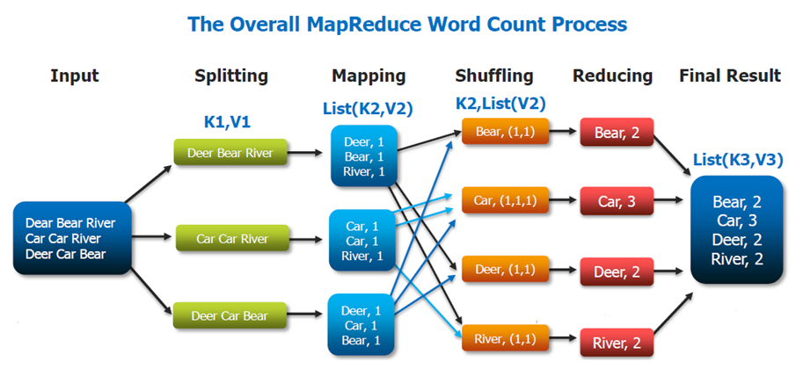
Map Reduce Example

Slide 26
Map Reduce Classes
Mapper: Mapper maps input key/value pairs to a set of intermediate key/value pairs. The Hadoop Map Reduce framework spawns one map task for each Input Split generated by the Input Format for the job.
Reducer: Reducer reduces a set of intermediate values which share a key to a smaller set of values. The number of reduces for the job is set by the user via Job.setNumReduceTasks(int).
Combiner: A Combiner, also known as a semi-reducer, is an optional class that operates by accepting the inputs from the Map class and thereafter passing the output key-value pairs to the Reducer class. The main function of a Combiner is to summarize the map output records with the same key. The output (key-value collection) of the combiner will be sent over the network to the actual Reducer task as input.
Partitioner: Partitioner controls the partitioning of the keys of the intermediate map-outputs. The key (or a subset of the key) is used to derive the partition, typically by a hash function.

Slide 27

Hive
The Apache Hive data warehouse software facilitates reading, writing, and managing large datasets residing in distributed storage using SQL. Structure can be projected onto data already in storage. A command line tool and JDBC driver are provided to connect users to Hive.
Hive is designed to enable easy data summarization, ad-hoc querying and analysis of large volumes of data. It provides SQL which enables users to do ad-hoc querying, summarization and data analysis easily. At the same time, Hive's SQL gives users multiple places to integrate their own functionality to do custom analysis, such as User Defined Functions (UDFs).

Slide 28

PIG
Apache Pig is a platform for analyzing large data sets that consists of a high-level language for expressing data analysis programs, coupled with infrastructure for evaluating these programs. The salient property of Pig programs is that their structure is amenable to substantial parallelization, which in turns enables them to handle very large data sets.
Key Properties:
Ease of Programming
Optimization opportunities
Extensibility
Two modes of Pig:
Local Mode
Map reduce Mode

Slide 29

HBase
Apache HBase is an open-source, distributed, versioned, non-relational database modeled after Google's Bigtable: A Distributed Storage System for Structured Data by Chang et al. Just as Bigtable leverages the distributed data storage provided by the Google File System, Apache HBase provides Bigtable-like capabilities on top of Hadoop and HDFS.
HBase is a type of "NoSQL" database.
HBase is really more a "Data Store" than "Data Base" because it lacks many of the features you find in an RDBMS, such as typed columns, secondary indexes, triggers, and advanced query languages, etc.

Slide 30
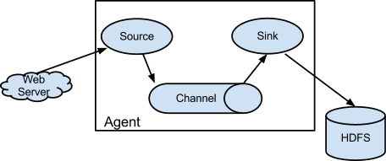

Flume
Flume is a distributed, reliable, and available service for efficiently collecting, aggregating, and moving large amounts of log data. It has a simple and flexible architecture based on streaming data flows. It is robust and fault tolerant with tunable reliability mechanisms and many failover and recovery mechanisms. It uses a simple extensible data model that allows for online analytic application.

Slide 31
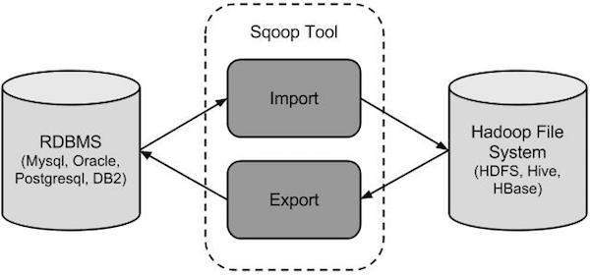
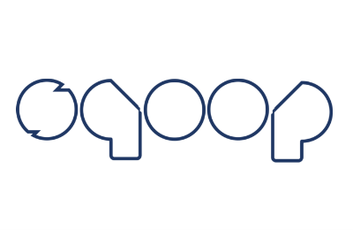
Sqoop
Apache Sqoop is a tool designed for efficiently transferring bulk data between Apache Hadoop and structured datastores such as relational databases.
You can use Sqoop to import data from external structured datastores into Hadoop Distributed File System or related systems like Hive and HBase.
Conversely, Sqoop can be used to extract data from Hadoop and export it to external structured datastores such as relational databases and enterprise data warehouses.

Slide 32

Zookeeper
ZooKeeper is a centralized service for maintaining configuration information, naming, providing distributed synchronization, and providing group services. All of these kinds of services are used in some form or another by distributed applications.
Each time they are implemented there is a lot of work that goes into fixing the bugs and race conditions that are inevitable. Because of the difficulty of implementing these kinds of services, applications initially usually skimp on them ,which make them brittle in the presence of change and difficult to manage.
Even when done correctly, different implementations of these services lead to management complexity when the applications are deployed.

Slide 33
THANK YOU

